Slide 1
Basics of ML Round 2
Aiden Tepper
Informatics Skunkworks (MSE 299), 2 Credits
02-23-2021

Slide 2
Hours Summary
Date | Hours | Description of Work
2/22/21 | 2 | Worked through sections 1-4
2/23/21 | 2 | Worked through sections 5-7 and made slide deck

Slide 3
Progress
The task assigned this week was to work through the same Introduction to Machine Learning Jupyter notebook as last week, but this time importing and using one of the data files from the Introduction to Citrination module to create the ML model
There were 7 sections that walked us through creating, training, testing, and optimizing a machine learning model, which we worked through using the fatigue strength data instead of the default band gap data
The best way to represent results from this week’s tasks is through the results from running snippets of code on the notebook, in the form of either tables or charts/graphs

Slide 4
Problems
I experienced some confusion in sections 5 and 6 when comparing the training/test data parity plots with their optimized counterparts, as the graphs showed weaker correlation than I expected and the data was grouped along horizontal lines, as well as the fact that I saw no difference between the original and optimized models
This is an issue I’d like to further explore and I have not found a solution/answer as of yet
Although procedurally this week’s activities were almost identical to last week’s, I struggled to follow along and make sure the results were valid at each step
To solve this, I could carefully scroll through the procedure from top to bottom and make sure the code is doing what it should at every step

Slide 5
Questions
Nothing about the procedure was specifically confusing to me
However, similar to last week I would like to go over either in small groups or as a whole a couple steps of the procedure to make sure I fully understand what was going on behind the scenes during certain steps
We covered a few of the confusing steps in last week’s meeting, but I wouldn’t mind taking an in-depth look at some of the code and see how it differs with this week’s data as opposed to last week’s
I would like to closely go through sections 6 and 7 (optimizing hyperparameters) and see what specifically happens to the model when we optimize it
I understood how it worked with the last data, but this data is formatted differently and I struggled to make connections

Slide 6
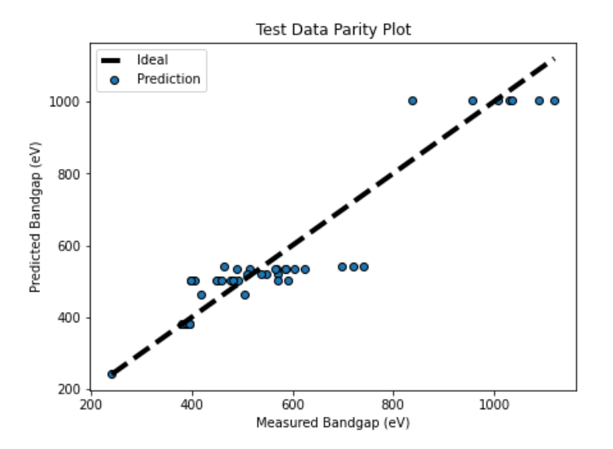
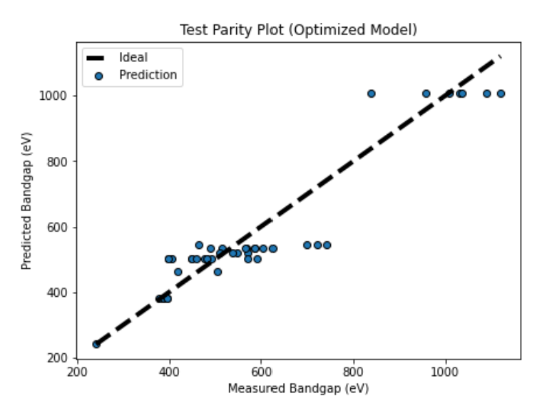
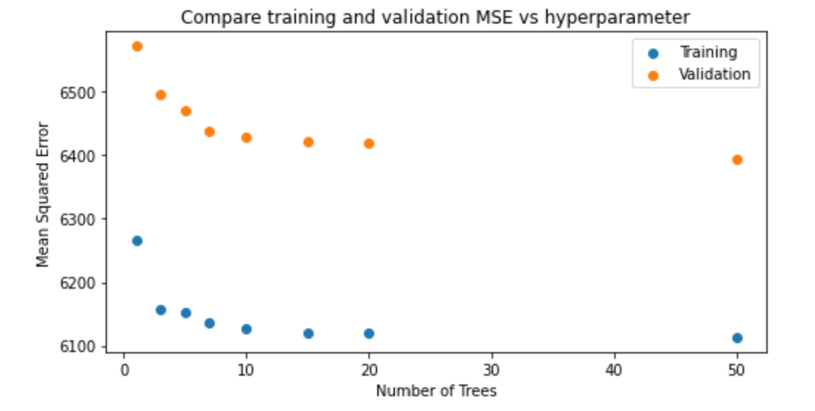
Assessment Figures

